Slide 1
Lecture on Automata (Transducer, Accepter), Deterministic Finite Automata - DFA
By
Dr. M. Senthilkumar
Assistant Professor (SG), CSE Dept,
ASE, CBE

Slide 2
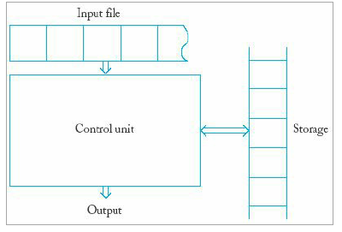
Automata
An automaton is an abstract model of a digital computer.
Schematic representation of a general automaton
As shown in Figure, an automaton:
reads input from an input file -- one symbol from each cell -- left to right
produces output
may use storage -- unlimited number of cells (may be different alphabet)
has a control unit
finite number of states
state changes in defined manner
"next-state" or transition function -- specifies state changes

Slide 3
Automata – Contd…
A configuration is a state of the control unit, input, and storage.
A move is a transition from one state configuration to another.
Automata can be categorized based on control:
A deterministic automaton has a unique next state from the current configuration.
A nondeterministic automaton has several possible next states.

Slide 4
Accepter and Transducer
Automata can also be categorized based on output:
An accepter has only yes/no output.
A transducer has strings or symbols for output.
Various models differ in
how the output is produced
the nature of temporary storage
Ref -https://john.cs.olemiss.edu/~hcc/csci311/notes/chap01/ch01.html#automata

Slide 5
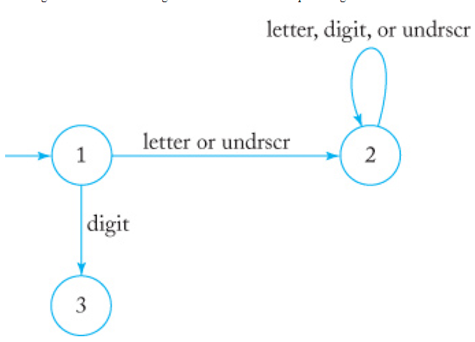
Some Application of Automata
Consider Syntax rules for identifiers in the language C are as follows:
An identifier is a sequence of letters, digits, and underscores.
An identifier must start with a letter or underscore.
Identifiers allow both uppercase and lowercase letters.
drawing of an automaton that accepts all legal C identifiers as defined above.

Slide 6
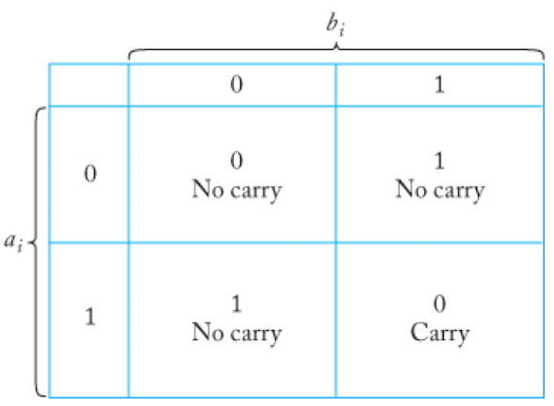
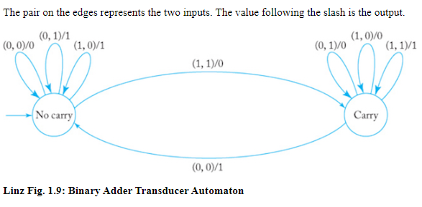
Transducer – An Example
Example – Transducer for Binary Adder

Slide 7
Deterministic Finite Accepters (DFAs)
A deterministic finite accepter, or dfa or DFA, is defined by the 5-tuple
M = (Q, Σ, δ, q0, F) where
Q is a finite set of internal states
Σ is a finite set of symbols called the input alphabet
δ : Q × Σ → Q is a total function called the transition function q0 ∈ Q is the initial state.
F ⊆ Q is a set of final states.
Transition function δ → For example, if δ (q0, a) = q1,
then if the dfa is in state q0 and the current input symbol is a, the dfa will go into state q1.

Slide 8
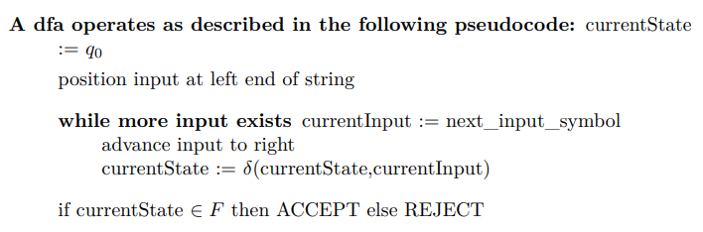
DFA - Working Mechanism - Operation

Slide 9

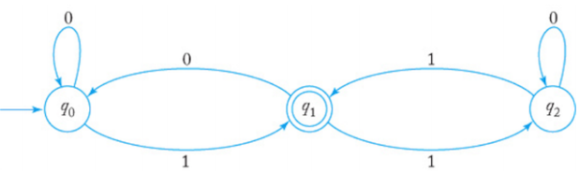
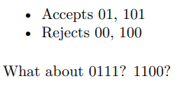
Transition Graph for DFA
To visualize a DFA, a transition graph is constructed as follows:
Vertices represent states – labels are state names – exactly one vertex for every qi ∈ Q
Directed edges represent transitions – label on edge is current input symbol – directed edge (q, r) with label a if and only if δ(q, a) = r
Graph pictured in Figure represents DFA M = ({q0, q1, q2}, {0, 1}, δ, q0, {q1}), where δ is represented by

Slide 10
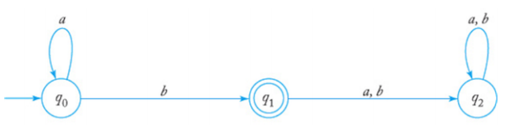
DFA Transition Graph with Trap State
Transition graphs are quite convenient for understanding finite automata
A trap state is a state from which the automaton can never “escape”.
Note: q2 has two self-loop edges, each with a different label. We write this compactly with multiple labels.
q2 is a trap state in DFA transition graph

Slide 11
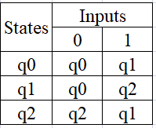
Tabular representation of transition function δ
Consider the same DFA
M = ({q0, q1, q2}, {0, 1}, δ, q0, {q1}), where δ is represented by
Transition Table →

Slide 12
Quiz on DFA and Transducer
Attached as a word doc
(filename Quiz QsAs-DFA and Transducer_MSK.doc)

Slide 13
Thank You

